Slide 1
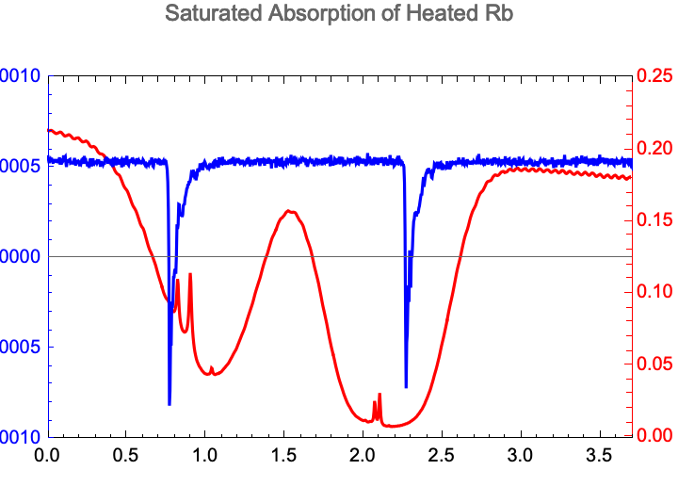
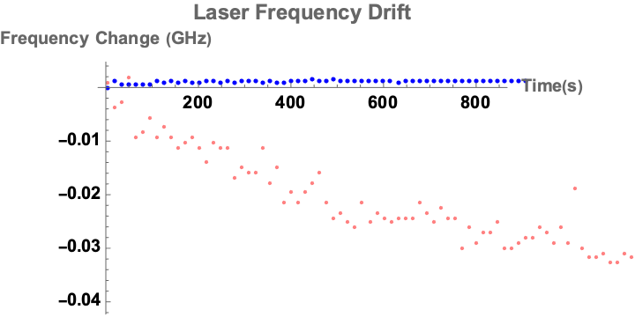
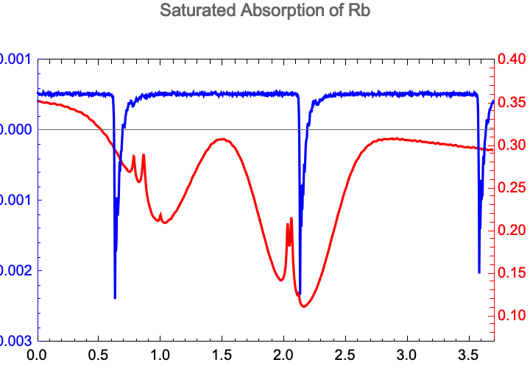
Week of July 30th
Ran laser drift trials to test laser lock
Collected data on the Doppler-broadening of heated Rb cell
Next Goal: Add a reference beam to isolate Doppler-free peaks
Frequency Change (GHz)
Frequency Change (GHz)
C. Zehnder

